Slide 1
CIS 5930 Productivity in Software Engineering Project
“Technical Debt Cripples Software Developer Productivity”
Jordan Gethers, Sineha Aneel, Aditi Allady

Slide 2
Tasks completed
Created question bank
Created questionnaire
Sent out the questionnaire
Sent reminders for questionnaire
Received expected number of responses for questionnaire
Initial analysis of responses
Thorough analysis of the responses
Compare and contrast with our hypothesis
Compare results with the chosen paper
Create visualizations
Finalize and document results

Slide 3
Questionnaire
https://forms.gle/LySbh5d9jqouyE2U6

Slide 4
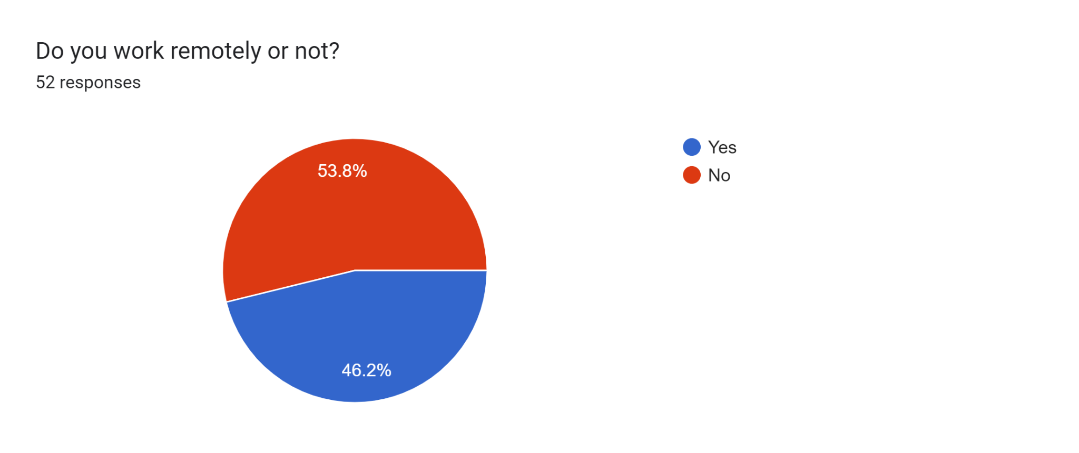
Questions of interest
Do you work remotely?
Notes:
Remote work seems to be typical instead of a small minority

Slide 5
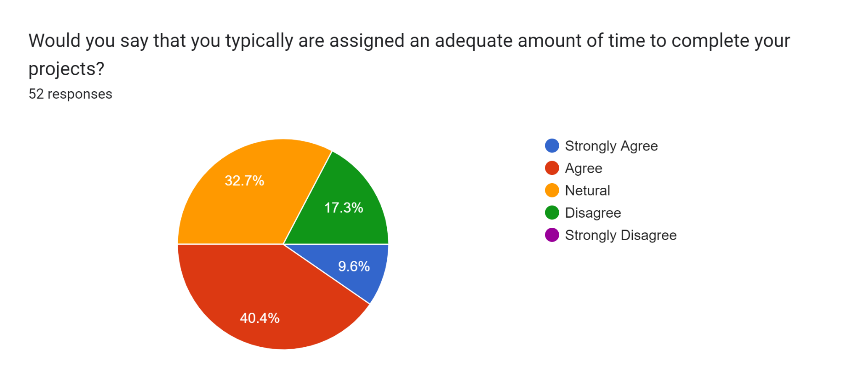
Questions of interest
Would you say that you typically are assigned an adequate amount of time to complete your projects?

Slide 6
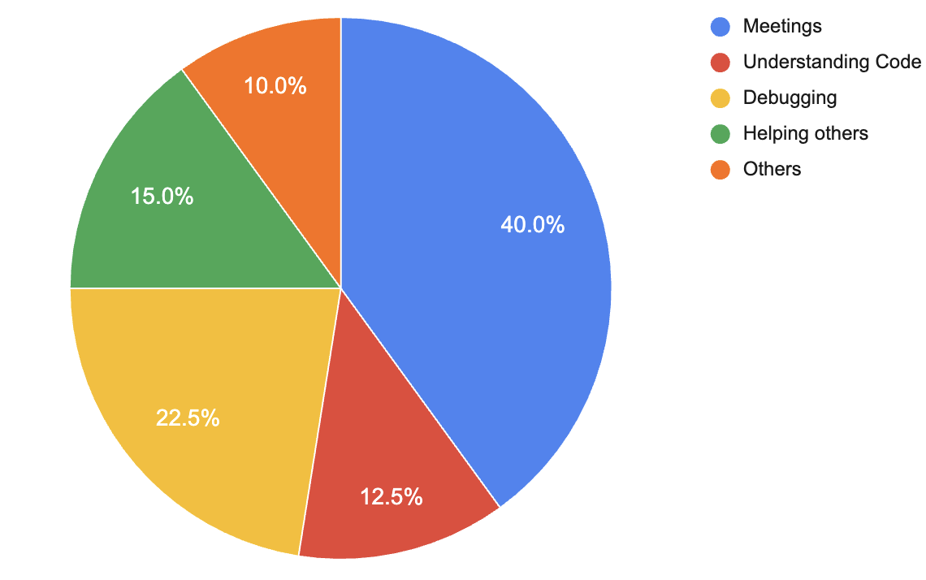
Main Sources of Technical Debt
The original studies main source of claimed technical debt was additional testing for code. With our study, the main source of claimed technical debt was unnecessary meetings or wasted meeting time.
We believe this difference could have to do with the difference in preferred programming languages, work environment differences and demographic differences between the two cohorts

Slide 7
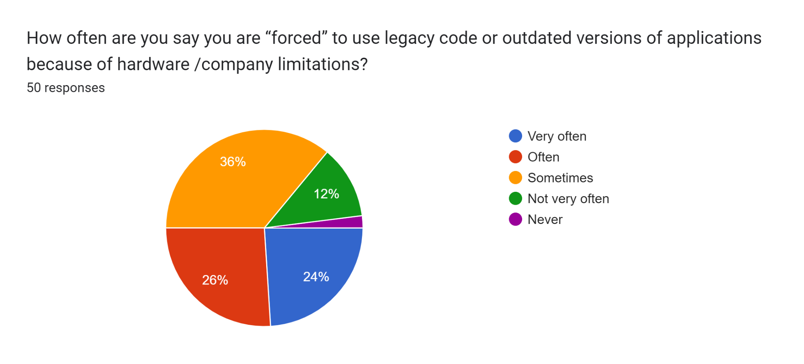
Legacy/Outdated Code
Other top contributor to Technical Debt
Notes:
Although we are continuously building new technologies, it seems as though the industry is always quite a bit behind current best practices and standards.

Slide 8
Compare/Contrast to the paper “Technical Debt Cripples Software Developer Productivity”
Wasted Time
Additional Activities
Technical Debt types
Awareness and challenges

Slide 9
Wasted Time
To determine development time lost to TD
We developed two distinct sets of questions
Meetings, followed by understanding code and additional refactoring is most strongly linked to wasted time
Apart from taking part in this study, none of the developers specifically measured, recorded, or reported the time they wasted, yet they still believed they had a high level of awareness of the time they lost because of TD.
It suggests, if the software companies are unaware of this time, they could easily find themselves under time pressure and be compelled to add more TD.

Slide 10
Additional Activities
Aimed to investigate which activities consumed the wasted time and whether the quantity of wasted time was associated with any particular activity
Meetings, followed by completing additional testing, followed by additional source code analysis and additional refactoring, is the task on which the extra time was typically spent.
Result suggests that the time spent on these operations may be decreased if the systems lacked TD.
Having to attempt additional tasks results in a sign that a system has TD as well as a sign of lower level of interest by developers.

Slide 11
Technical Debt Types
Our research reveals that all other TD types are significant and strongly correlated with the amount of wasted time, with source code TD having the strongest correlation with wasted time.
It might be because developers are more aware of Source Code TD and hence perceive the negative effects of it to be more pronounced.
Findings indicate that developers encounter fewer Infrastructure TD and Requirement TD, suggesting that developers are less likely to attribute their wasted time to those TD types.
It further suggests that software businesses should concentrate on a variety of TD and, less frequently today, should not just concentrate on TD that is related to code only.

Slide 12
Awareness and Challenges
We examine the developers' levels of awareness of the time lost to TD, the advantages of this knowledge, and the internal messaging they use inside their businesses.
The findings show that software engineers are reasonably aware of the amount of time they waste during the development phase.
This implies that, in the worst-case situation, developer productivity and the amount of wasted time could actually grow.
It is also observed that TD affects’ the mental health of software engineers to some extent with over 26% claiming it happens oftenly.

Slide 13
Limitation/ Future Works
To reproduce the findings in different geographic locations and software development cultures, more research is required

Slide 14
Conclusions
This study offers proof that TD impedes software engineers by creating a lot of unnecessary time waste.
Lost time has a detrimental impact on the software's viability and development productivity
Demonstrates that TD also contributes to the requirement for executing time-consuming additional tasks
Developers frequently have to conduct additional testing, source code analysis, and refactoring due to the presence of TD during the development work
Results suggest that in order for software businesses to measure TD interest, they must be prepared with techniques and proactive management.

Slide 15
Contributions
Aditi Allady
Created the Github
Created the Technical Debt Questionnaire Form
Wrote some of the Technical Debt Questions
Wrote some of the project proposal
Asked people to answer a questionnaire in the class, and other people in other classes and also who work in the cs department to answer the questionnaire(got 17 people to answer)
Sent a reminder to the participants who have not filled out the form yet
Merged short answer question for better results visualization
Wrote the compare and contrast, future work and conclusion section
Proofread and formatted the report
Participated in team meetings for general discussion and helping other teammates

Slide 16
Contributions
Sineha Aneel
Asked people to answer a questionnaire in the class, and other people in other classes and also who work in the cs department to answer the questionnaire(got 17 people to answer)
Wrote some of the project proposal
Wrote some of the Technical Debt Questions
Sent a reminder to the participants who have not filled out the form yet
Merged 4 short answer questions for better results visualization
Created visualizations for merged questions
Wrote the compare and contrast, future work and conclusion section
Proofread and formatted the report
Participated in team meetings for general discussion and helping other teammates

Slide 17
Contributions
Jordan Gethers
Asked people to answer a questionnaire in the class, and other people in other classes and also who work in the cs department to answer the questionnaire(got 17 people to answer)
Wrote some of the project proposal
Wrote some of the Technical Debt Questions
Sent a reminder to the participants who have not filled out the form yet
Merged short answer question for better results visualization
Wrote the abstract, introduction and general analysis of the report
Proofread and formatted the report
Participated in team meetings for general discussion and helping other teammates

